Slide 1
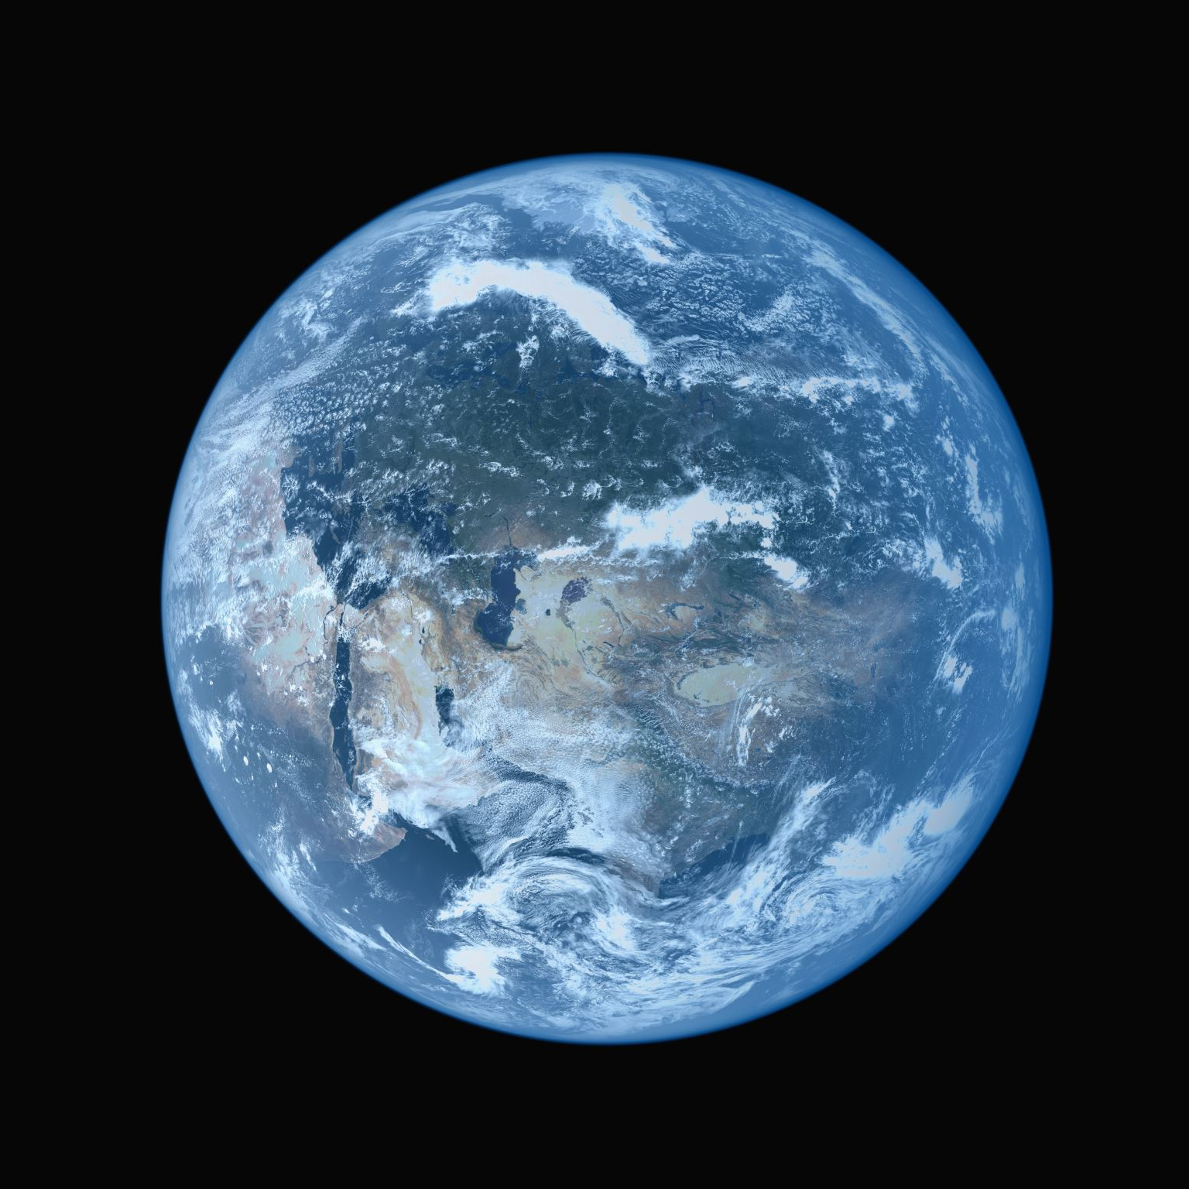
The Ionosphere
Exploring the decay of the Ionosphere and 𝞪 and 𝞫 recombination
Kasia Wisniewski

Slide 2
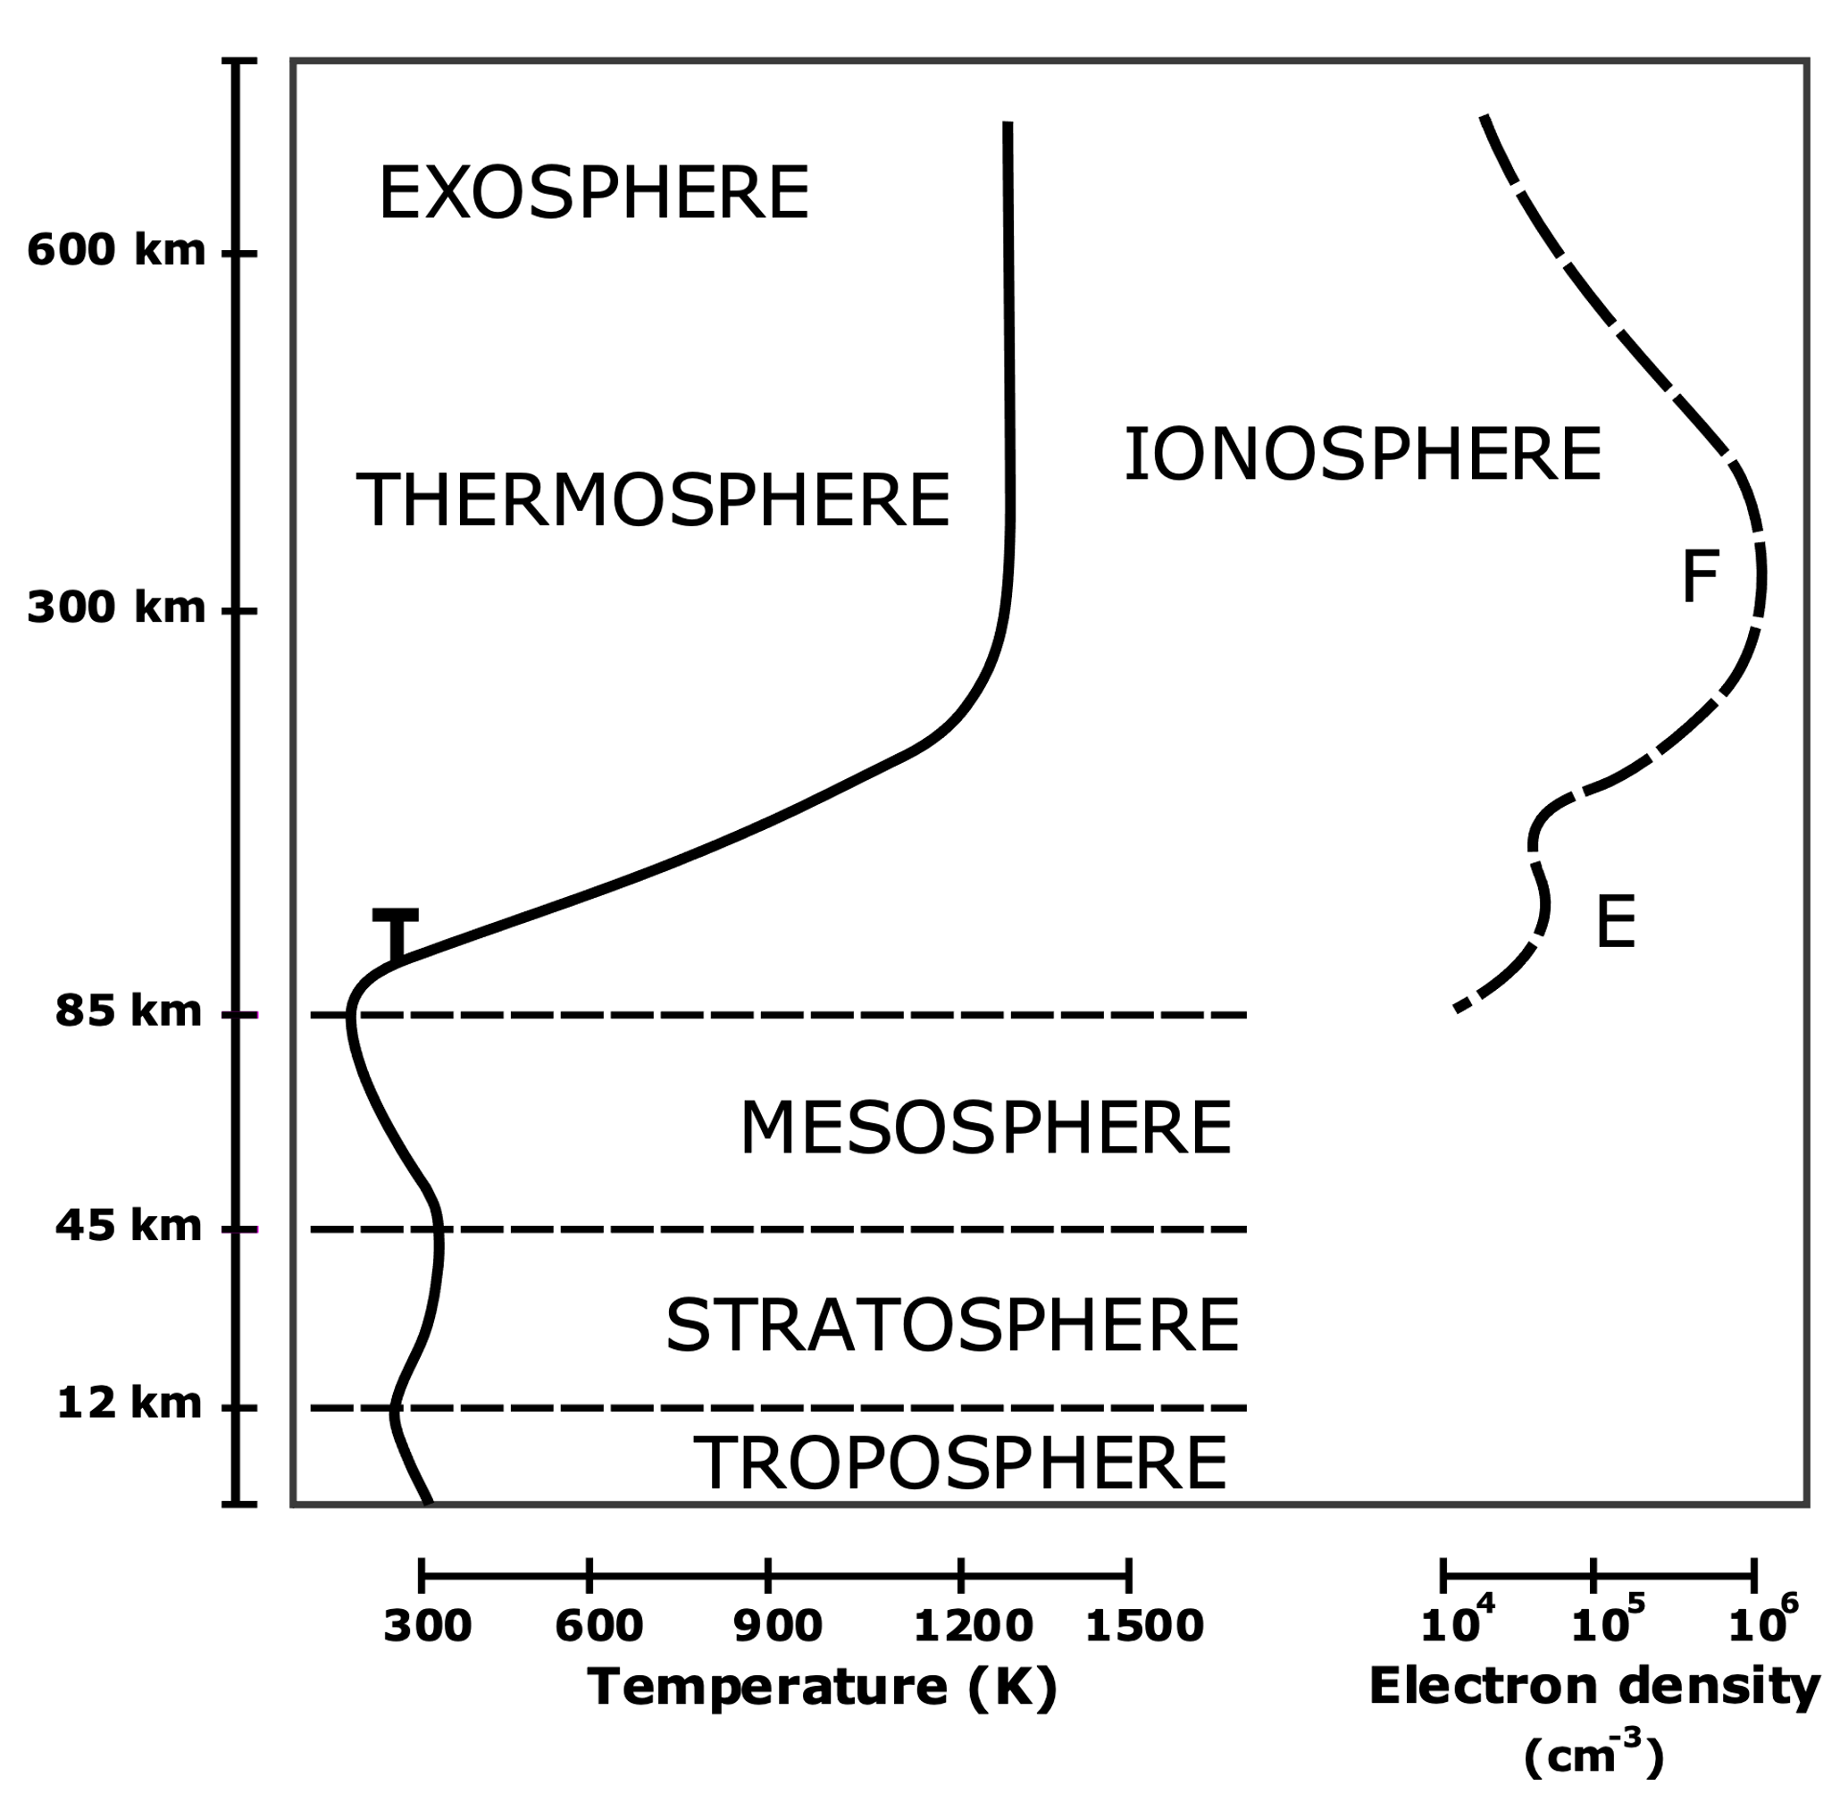
What is the Ionosphere?
The upper region of the atmosphere from approx. 60km to 500km [1]
Does include portions of the mesosphere, and thermosphere
Also, the ionized (charged) part of the atmosphere with mostly electrons and positively charged ions (some negative lower in the layer) [2]
By Bhamer, updated to SVG by tiZom - English Wikipedia, Public Domain, https://commons.wikimedia.org/w/index.php?curid=2178742

Slide 3
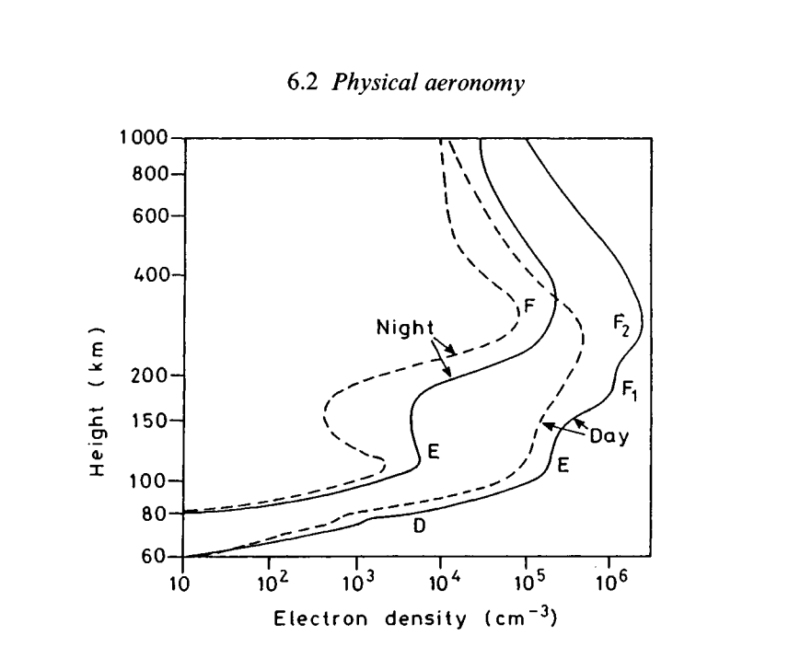
Layers of the Ionosphere
Within the Ionosphere are different layers
Layers are defined at the inflection points as we look at the electron density profile [1]
Dashed = sunspot min.
Solid = sunspot max.
As we can see, there are two profiles to describe the density for both day and night… but why?
Hargreaves, J. (1992). The Solar-Terrestrial Environment: An Introduction to Geospace - the Science of the Terrestrial Upper Atmosphere, Ionosphere, and Magnetosphere (Cambridge Atmospheric and Space Science Series). Cambridge: Cambridge University Press. doi:10.1017/CBO9780511628924

Slide 4
E and F Regions of Ionosphere
The differences between the day and night electron densities are quite large
Ionosphere is formed by ionization of gasses
The energy comes from solar radiation by EUV (extreme ultra-violet) and X-ray
During the day, recombination is at its peak
During the night, it decreases [3]
 | Day Time (m⁻³) | Nighttime (cm⁻³)
D Region | 10⁸-10¹⁰ | 10²-10⁴
E Region | 10¹¹ | 10⁵
F1 Region | ~10¹¹-10¹² | 10⁵-10⁶
F2 Region | 10¹² | 10⁶
Densities Taken from [3]

Slide 5

Dissociative Recombination
A dissociative recombination rection is given by[3]:
$$e^{−}+{XY}^{+}=X+Y$$
These are the primary reactions in the E Region, example of main ones are[3]:
$$e^{−}+{O_{2}}^{+}=O+O$$
$$e^{−}+{N_{2}}^{+}=N+N$$
$$e^{−}+{NO}^{+}=N+O$$

Slide 6

Charge-Exchange Reaction
A charge-exchange rection is given by[3]:
$$X^{−}+Y^{+}=X^{+}+Y^{−}$$
These are the primary reactions in the F1 Region, example of main ones are[3]:
$$O^{+}+{O_{2}}^{0}={O_{2}}^{+}+O$$
$$O^{+}+{N_{2}}^{0}={NO}^{+}+N$$

Slide 7


Rate of Electron Loss
If we assume electrons recombine directly with positive ions (ie. No negative ions present)
Rate, L:
$$L=αN^{2}$$
With 𝞪 being the recombination coefficient and N the electron density
Dominant at lower portions of the ionosphere
If we look at forming negative ions with the attachment of an electron
Rate, L:
$$L=βN$$
With 𝞫 being the attachment coefficient and N the electron density
Can be dominant at higher levels of the ionosphere

Slide 8
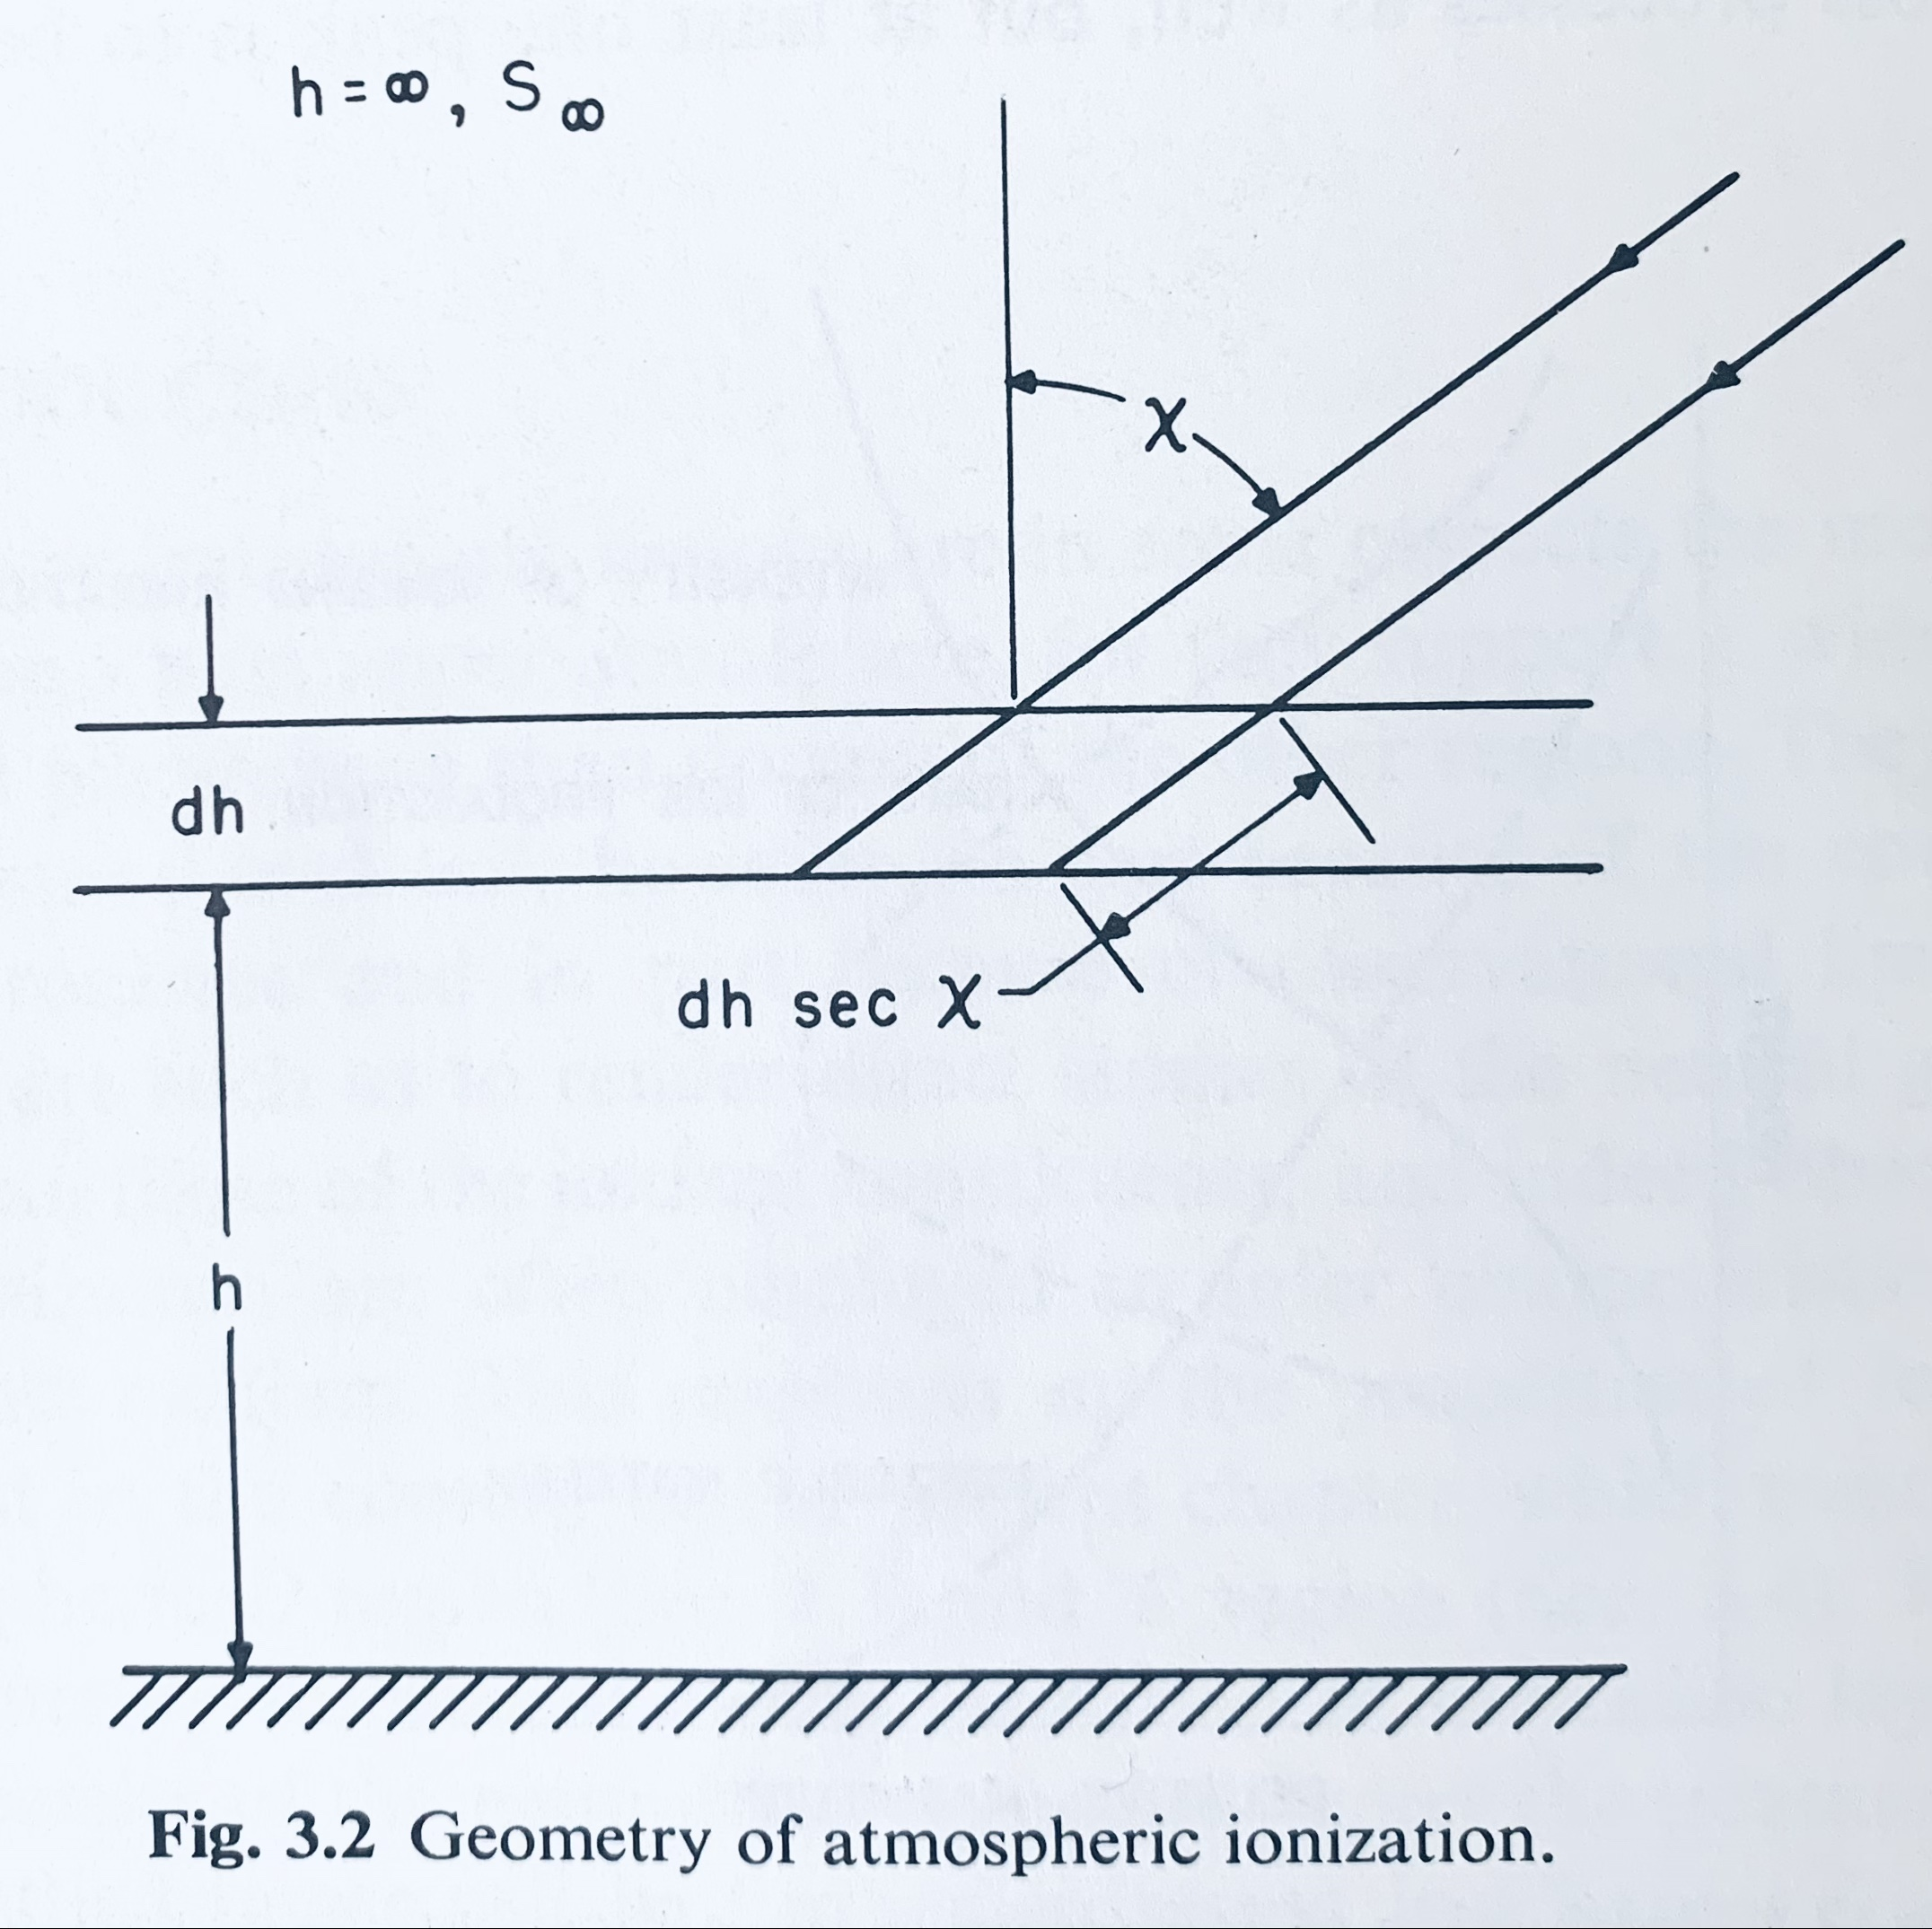
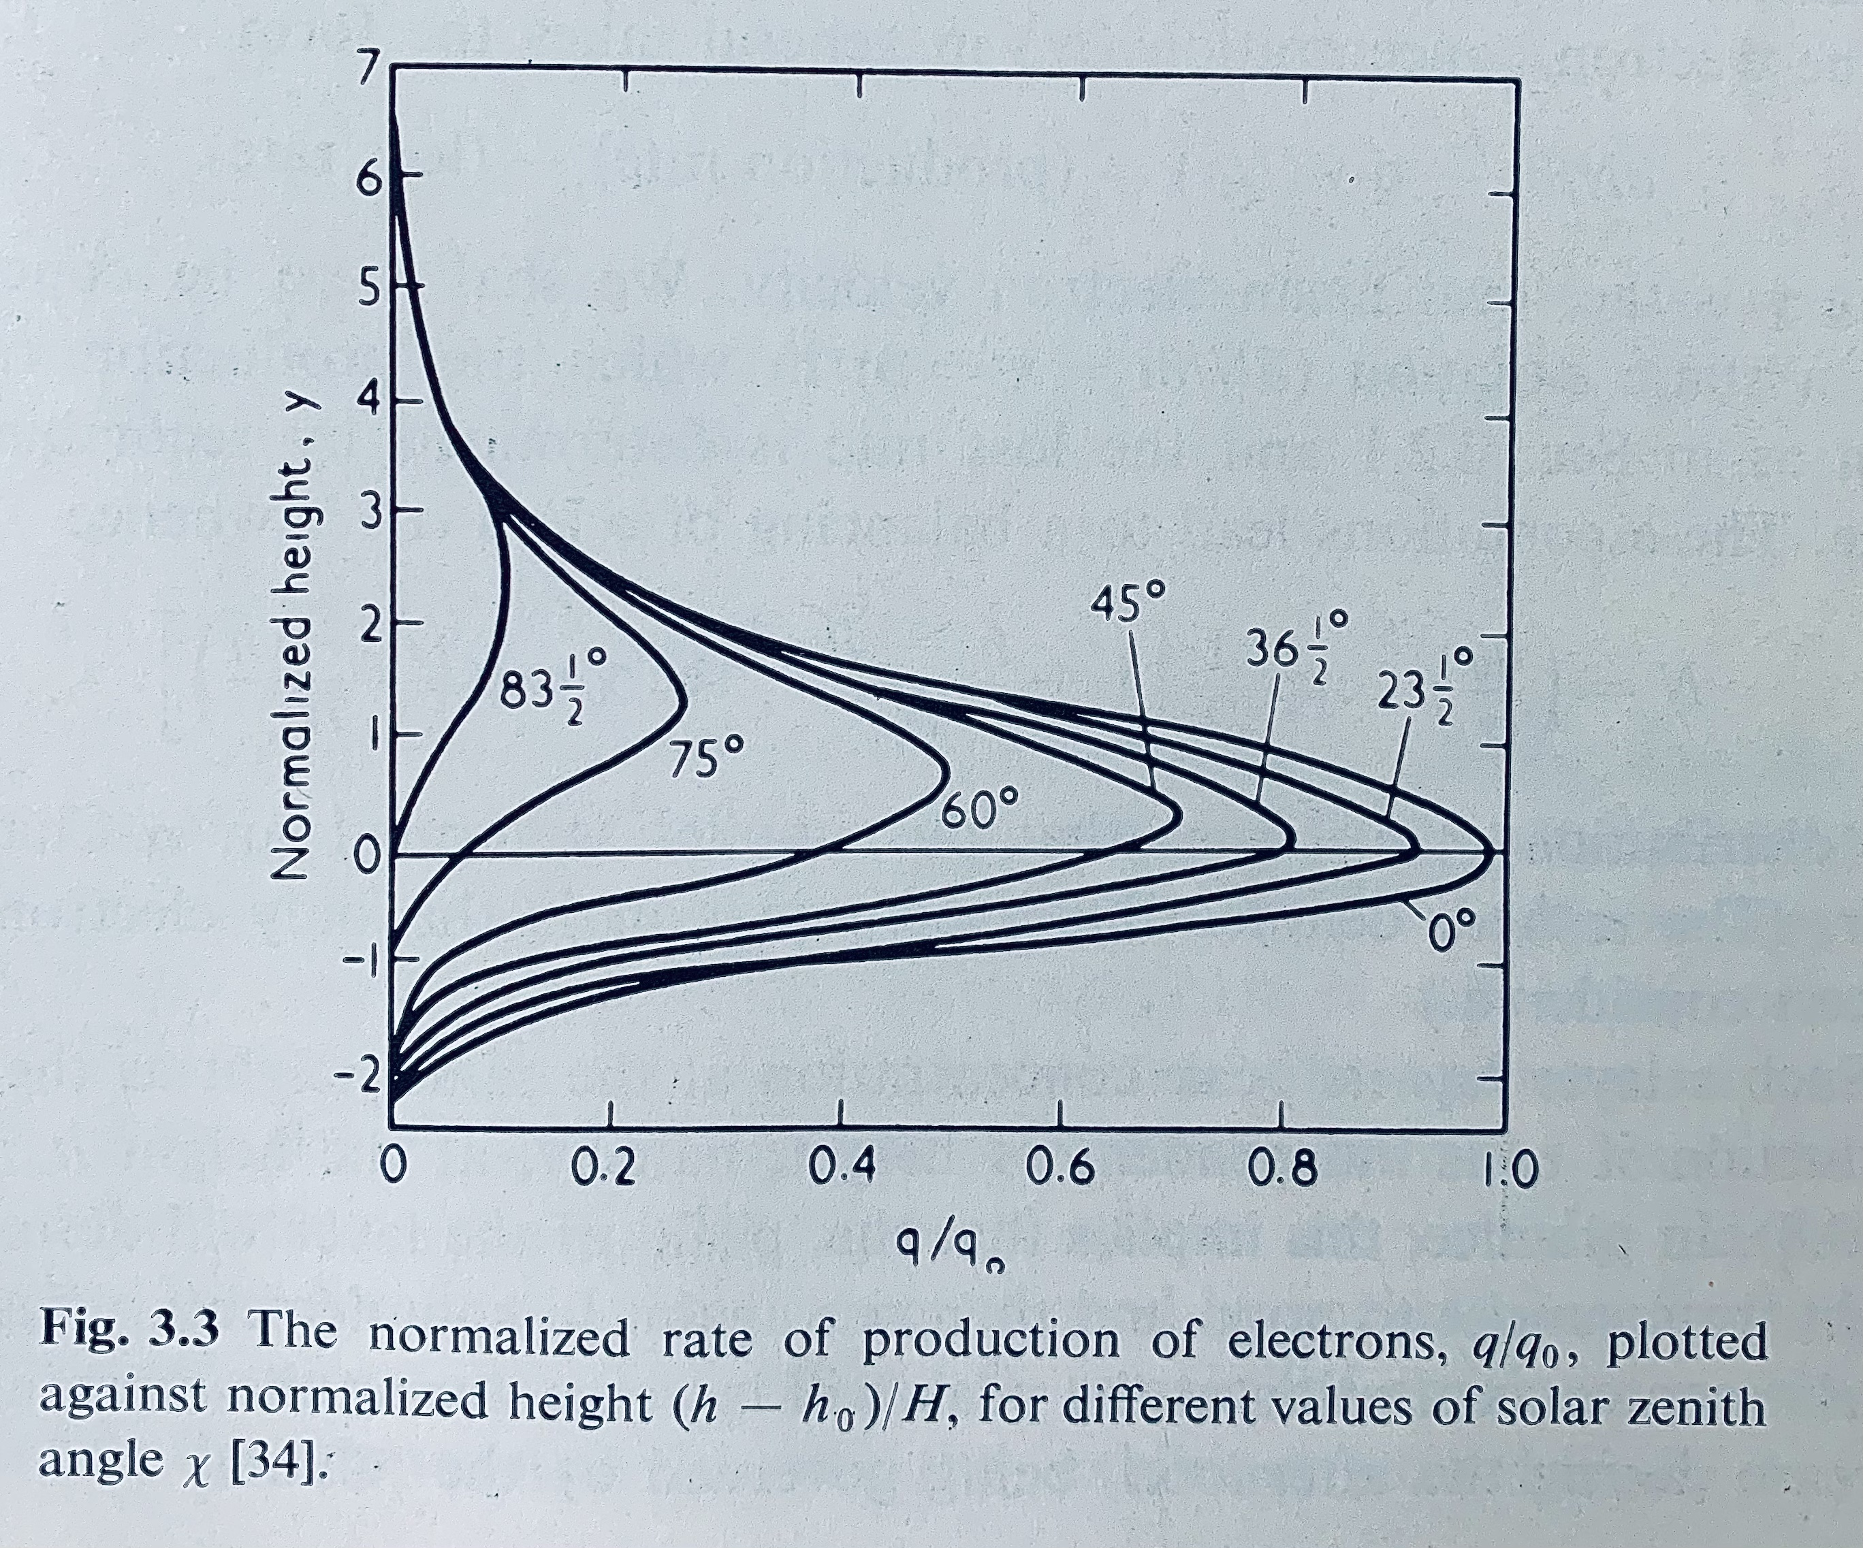


Recombination Rate
$\frac{dN}{dt}=q−αN^{2}$ [4, eq^{N} 1.6]
Where q is dependent on height as shown (equation a mix of [4 eq^{N} 1.5] and [5 eq^{N} 3.9]):
$$q=q_{0} exp⁡\left[1+\frac{z_{0}−z}{H}−secχ\exp\left(\frac{z_{0}−z}{H}\right)\right]$$
q= rate of production of electrons
$\frac{z_{0}−z}{H}$ is normalized height
z is height, H is scale height, $z_{0}$ is height taken at 𝜒=0 [5]
𝜒 is the angle at which the sun enters the atmosphere from the zenith point [4]
$q_{0}$is a constant
Both Left and Right: Hines, C. O. ed., & Barrington, R. E. (1965). Physics of the earth’s upper atmosphere (pg 48-49). Editors: C. O. Hines [and others]. Englewood Cliffs, N.J: Prentice-Hall [1965].

Slide 9

Recombination Rate Continued
A first approximation has $N_{0}={(\frac{q_{0}}{α})}^{1/2}$
Take $\frac{dN}{dt}=v=0$where v is the local mean velocity of an electron, we get a balance of q and $αN^{2}$ thus [5 eq^{N} 3.11]:
$$N={(\frac{q_{0}}{α})}^{1/2}exp⁡\left[1+\frac{z_{0}−z}{H}−secχ\exp\left(\frac{z_{0}−z}{H}\right)\right]$$
This is known at the Chapman law [4], or the 𝞪-Chapman Layer
Note that this approximation uses many assumptions, for example that the earth is a flat surface [4]
𝞪 is the recombination coefficient with an order of magnitude of 10⁻¹³ m³s⁻¹ [4]

Slide 10
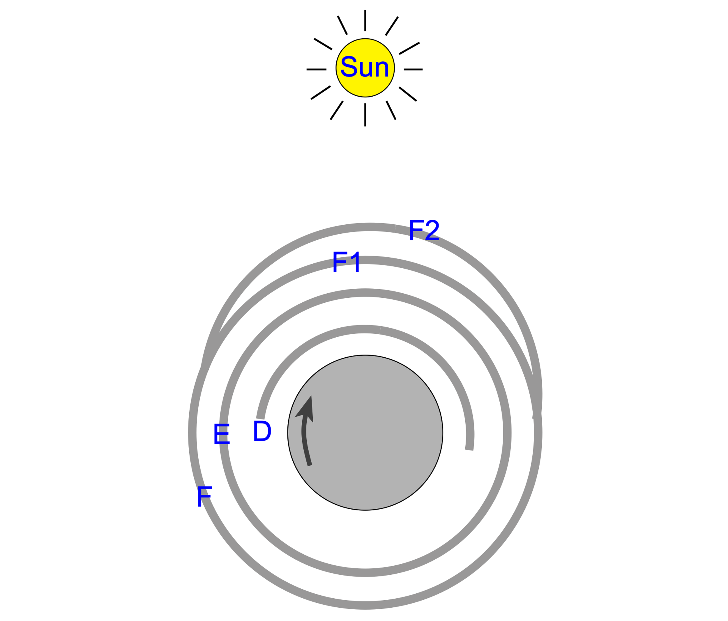
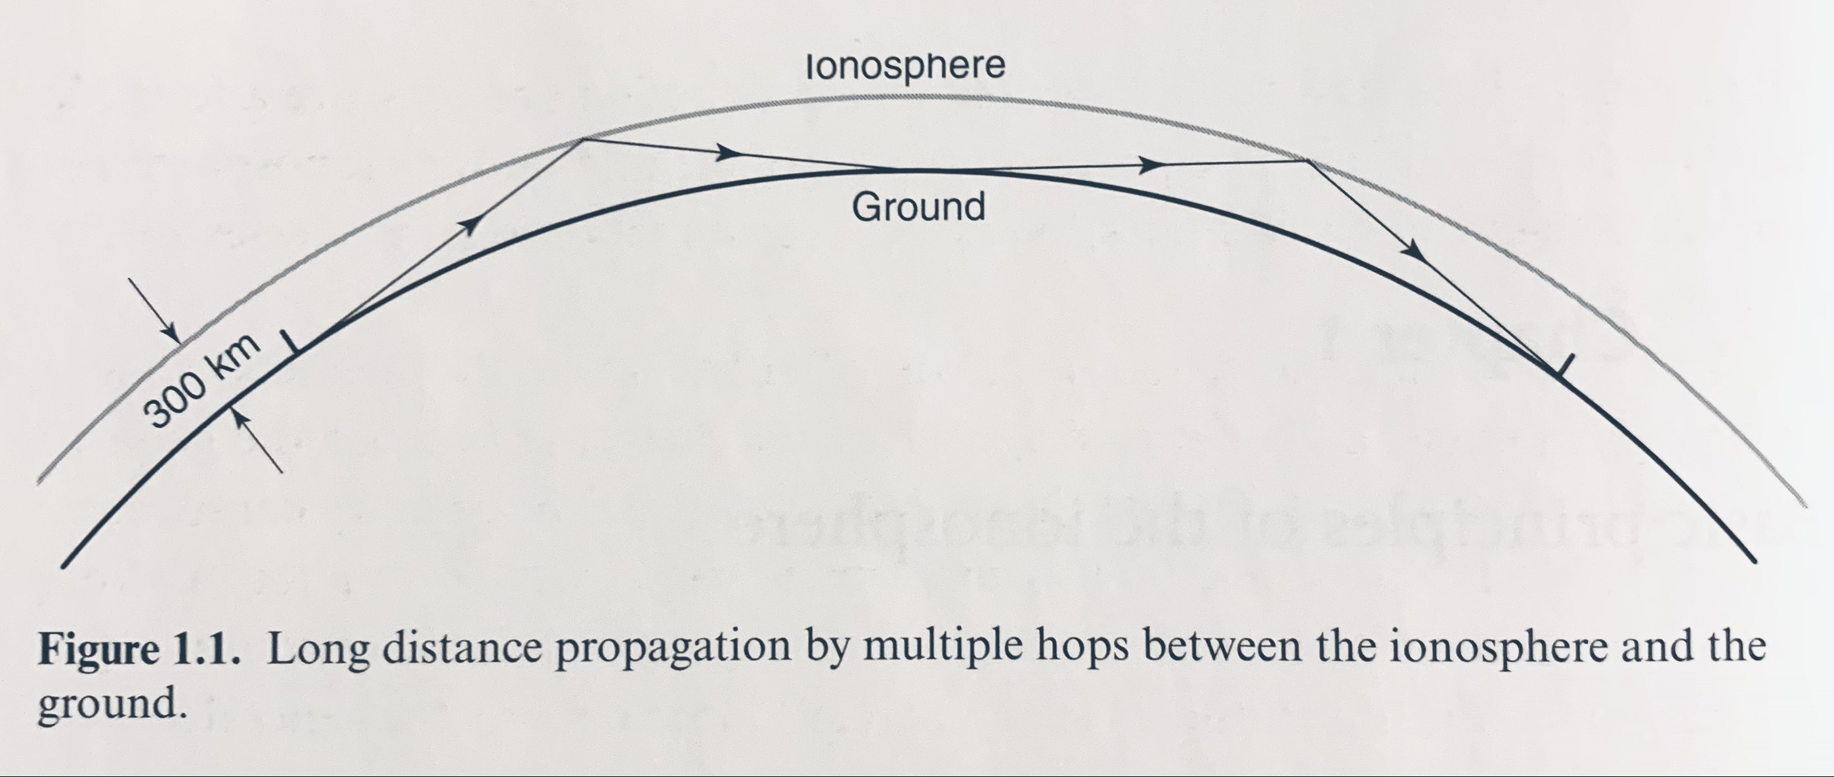
Effects on Radio Wave Propagation
Ionosphere radiowave propagation. Electronics Notes. (n.d.). Retrieved November 9, 2021, from https://www.electronics-notes.com/articles/antennas-propagation/ionospheric/ionosphere.php.
Radio Wave Propagation works by reflecting off other objects and are affected by the medium they travel through
Waves can bounce off free electrons and ions in the ionosphere
Since the Ionosphere acts like a mirror, it can reflect signals over the “bulge” of the surface [3]
However, lower layers of the Ionosphere can absorb signal (effects lower frequency waves) for high frequency waves can lost in space [3]
Hunsucker, R. D., & Hargreaves, J. K. (2003). The high-latitude ionosphere and its effects on radio propagation (pg 2) . Cambridge: Cambridge University Press.

Slide 11
References
[1] Gombosi, T. (1998). Physics of the Space Environment (Cambridge Atmospheric and Space Science Series). Cambridge: Cambridge University Press. doi:10.1017/CBO9780511529474
[2] Hargreaves, J. (1992). The Solar-Terrestrial Environment: An Introduction to Geospace - the Science of the Terrestrial Upper Atmosphere, Ionosphere, and Magnetosphere (Cambridge Atmospheric and Space Science Series). Cambridge: Cambridge University Press. doi:10.1017/CBO9780511628924
[3] Hunsucker, R. D., & Hargreaves, J. K. (2003). The high-latitude ionosphere and its effects on radio propagation . Cambridge: Cambridge University Press.
[4] Budden, K. G. (1985). The Propagation of Radio Waves: The Theory of Radio Waves of Low Power in the Ionosphere and Magnetosphere. Cambridge University Press. https://doi.org/10.1017/CBO9780511564321
[5] Hines, C. O. ed., & Barrington, R. E. (1965). Physics of the earth’s upper atmosphere. Editors: C. O. Hines [and others]. Englewood Cliffs, N.J: Prentice-Hall [1965].

